Slide 1
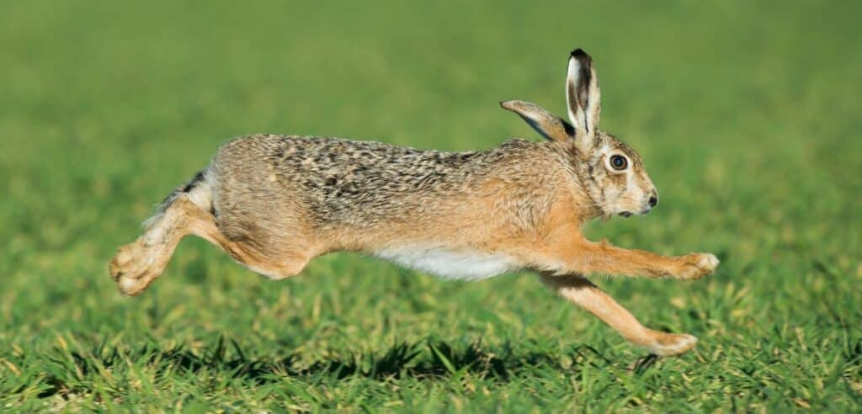
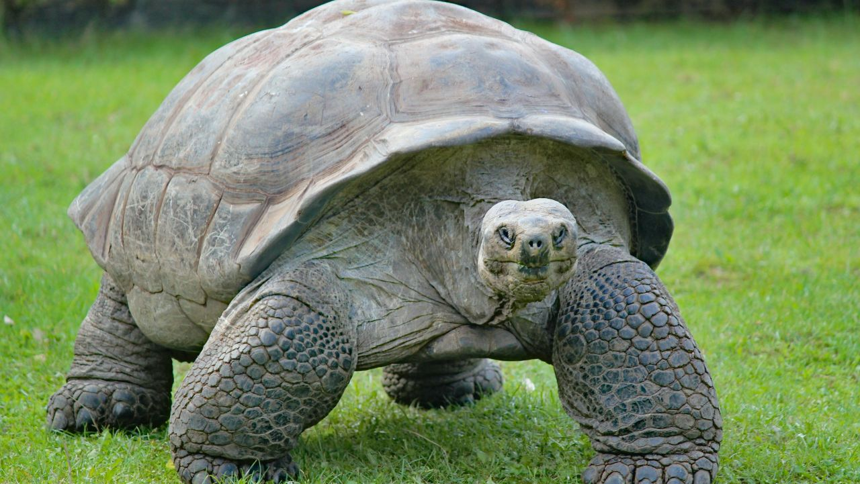
The physiology and energetics of alternative summer habitat use in Willamette cutthroat trout
Hannah Barrett & Jonny Armstrong
FWCS Oregon State University

Slide 2
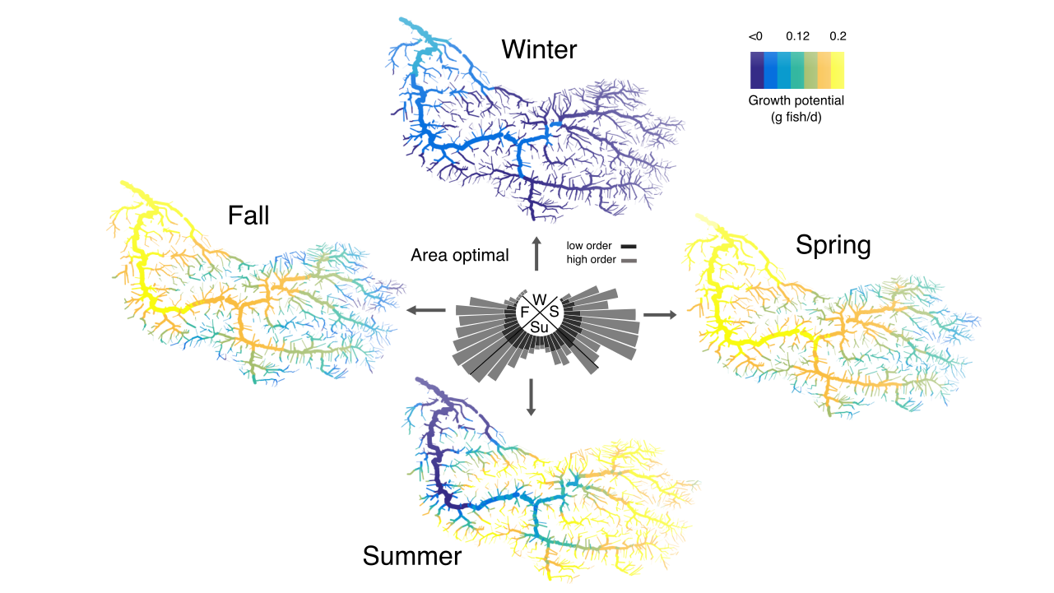
Landscape growth potential across seasons
The Growth Regime of Rivers
John Day River

Slide 3
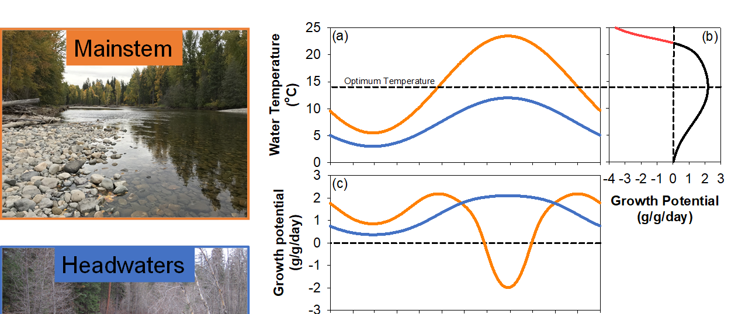
The Growth Regime of rivers
Unimodal
Bimodal
Riverscapes exhibit 3 peaks of physiological performance and two of them occur downstream

Slide 4
The Growth Regime of rivers
Unimodal
Bimodal
How can cold-water fish cope with warm summers in large rivers and other seasonally warm habitat?

Slide 5
3Three general options
Move to cool habitat nested within large rivers
Migrate to cold tributaries (or the ocean)
Tolerate high temperatures

Slide 6
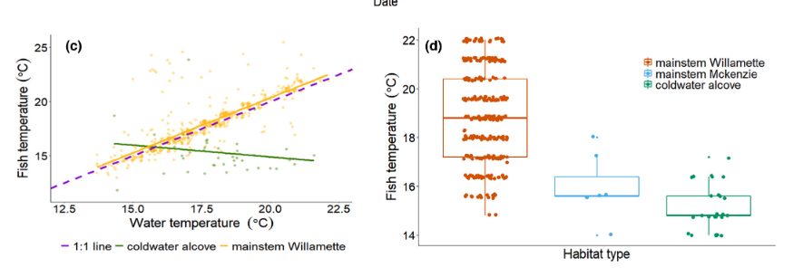
Willamette cutthroat: most tolerate and some move or migrate to much colder habitat
What are the energetic consequences of these strategies?
Barret and Armstrong 2022
Ecosphere

Slide 7
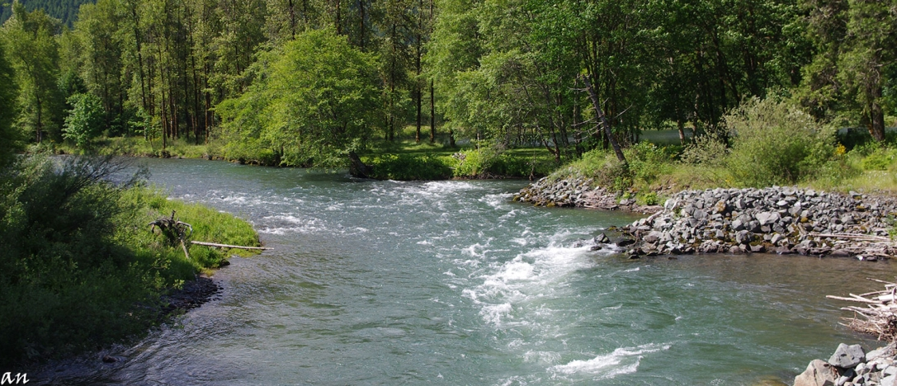
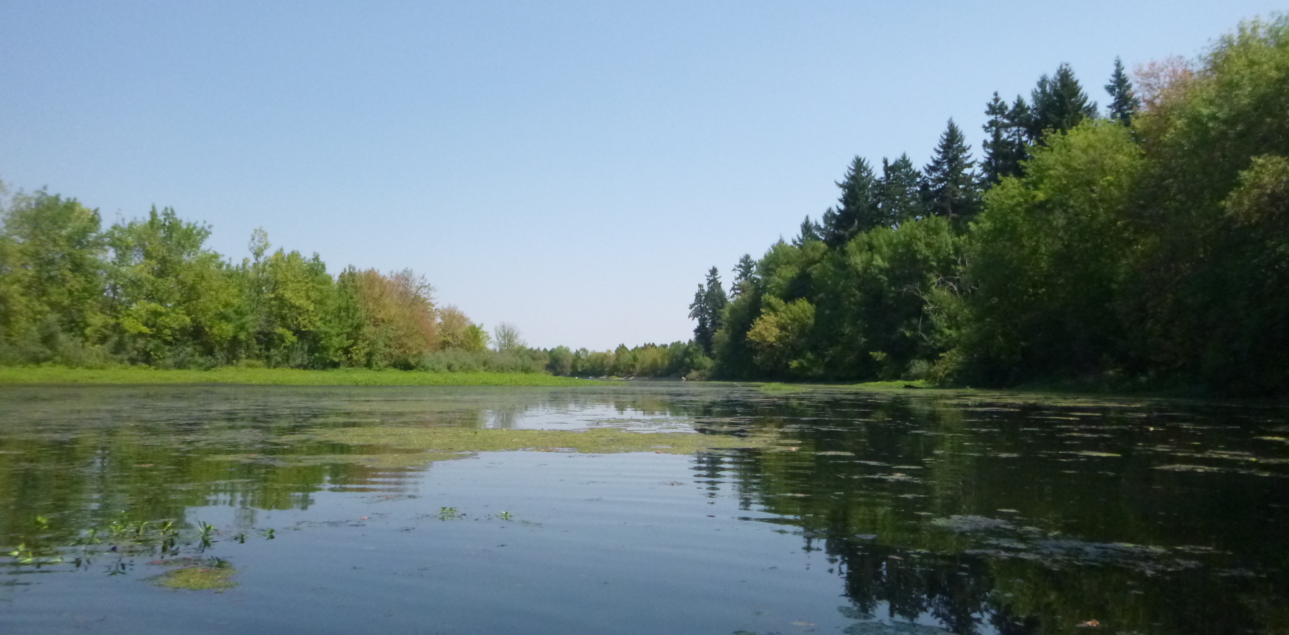
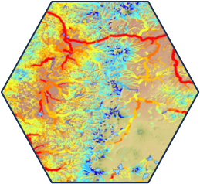
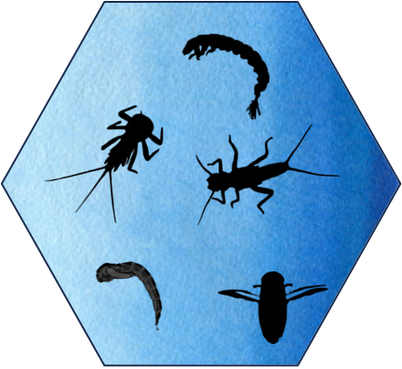
Mainstem Willamette (lotic)
Mainstem Willamette
Photo by Martyne Reesman
Warm
High velocity
Cold-water alcove (lentic)
Up to 10℃ cooler
Zero velocity
Alcove
Photo from USGS
Notes:
The mainstem river and cold-water alcoves present completely different habitats.
These are very different patterns of habitat with different associated conditions
What is the net energetic outcome between fish that use the mainstem versus fish that use alcoves?
For this study we sampled diet and growth of over 500 individuals captured in both ms and alcove habitats
and used bioenergetics models to quantify energy budgets. We also pit tagged fish, which allowed us to determine
recaptures
Not only higher basal metabolism, also in high velocity habitats (comparison)
Why is this the rare strategy if the energetic cost of doing it for both activity and basal

Slide 8
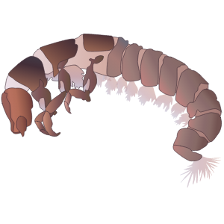
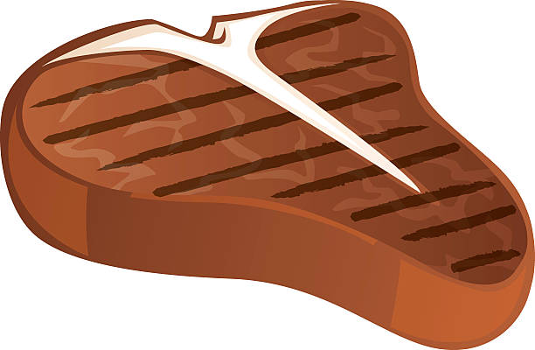
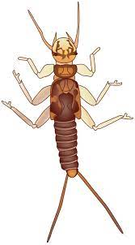
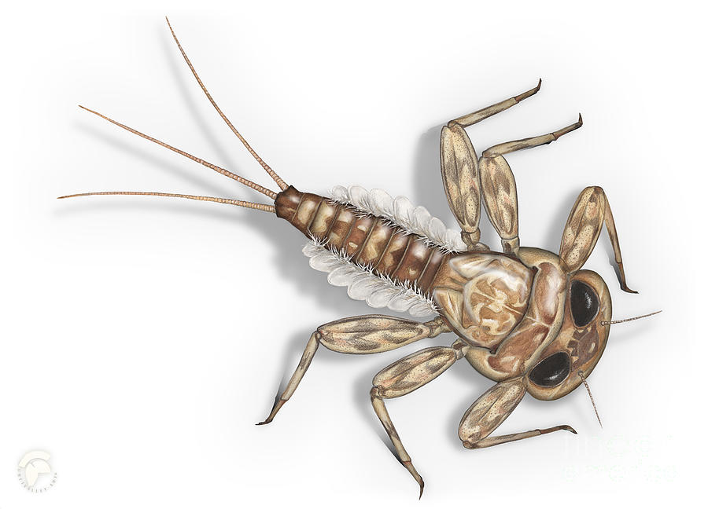
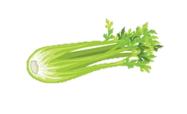
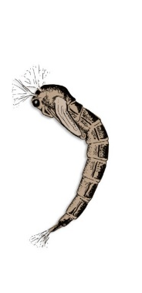
Gain Maximizing
Mainstem Willamette
Photo by Martyne Reesman
Higher basal metabolism
Higher activity costs
Higher energy gain
Efficiency Maximizing
Lower basal metabolism
Lower activity
Lower energy gain
Alcove
Photo from USGS
Notes:
By adding in diet data, we can now see that these two strategies are fundamentally different. We can now consider our mainstem fish to be…
Gym rats
Couch potato on a diet

Slide 9
Bioenergetics modeling
Growth = Consumption – Basal Metabolism
– Active Metabolism – Wastes
Notes:
What are the energetic outcomes? To answer this question we used a bioenergetics modeling approach. This is a mass balance equation that when simplified looks like this. Potential for growth is equal to the amount of food you consume, minus losses to metabolism and wastes. On the right we are looking at figures of a cutthroat congener, rainbow trout, and modeled rates of fish growth across a range of temperatures. when consumption is at a maximum, on the bottom consumption is constrained to 35% of maximum possible consumption (more realistic for a wild fish)

Slide 10
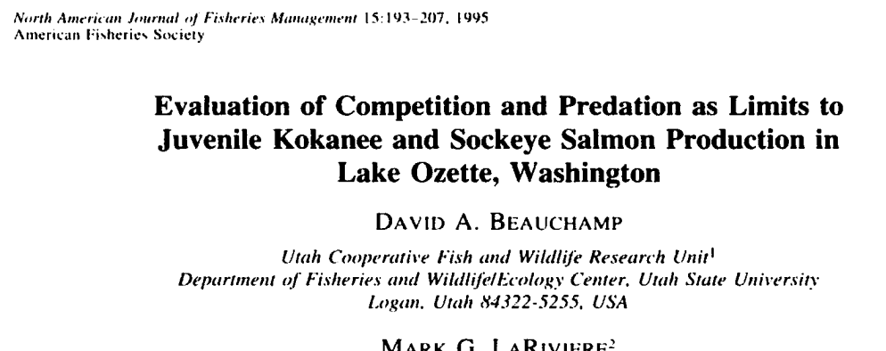
Are there cutthroat trout parameters?
Coho salmon model adjusted based on cutthroat from Utah, aerobic scope peaked at 15C

Slide 11
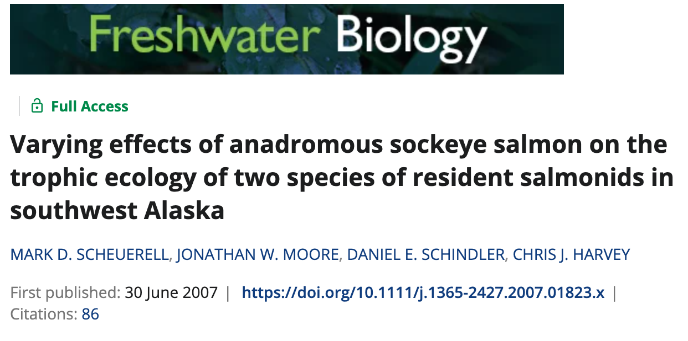
How to leverage both C and G data?

Slide 12
How do you consider activity costs?
MMR
RMR
Activity?

Slide 13
Our approach
Measure growth, diet, velocity, and temperature in the field
Based on the observed ratio of consumption between riffle and alcove habitats (and observed temperatures), solve for the activity costs that would result in the observed differences in growth
Simulate growth in a warmer future, under different assumptions of bioenergetic parameters

Slide 14
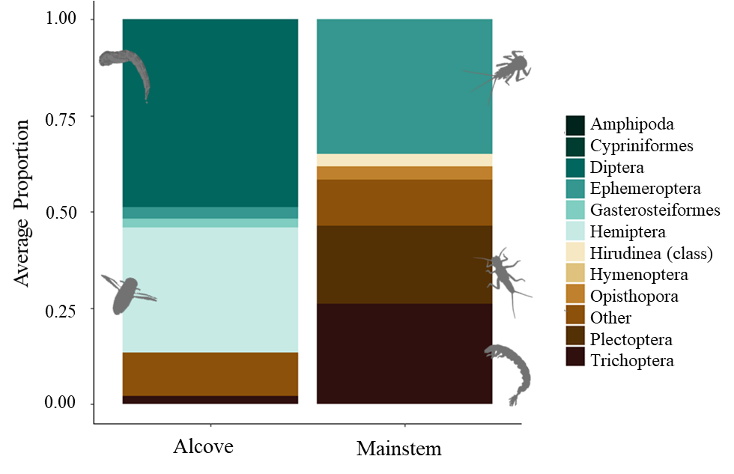
Characterizing diet
EPT taxa
Diet energy between habitats is completely different and ~3x’s higher in the mainstem!
Notes:
This is a graph showing the prey that provided the most diet energy per habitat.
In alcoves, 90% of the energy found in fish diets was comprised of water boatmen and chironomids.
Here, fish are opportunistically foraging on hypoxia tolerant prey in water column.
In the mainstem, 90% of the energy found in fish diets was comprised of msc, also known as EPT taxa, the stuff you’d imagine fish eating while drift feeding.
Diet analysis shows that these habitats present completely different food webs for cutthroat.
Not only are prey types different, but the total diet energy between habitats was dramatically different,
Mainstem diets had over 3Xs the amount of energy as alcove fish
Alcove fish average daily ration 17,400 Joules versus mainstem 55,500 Joules

Slide 15
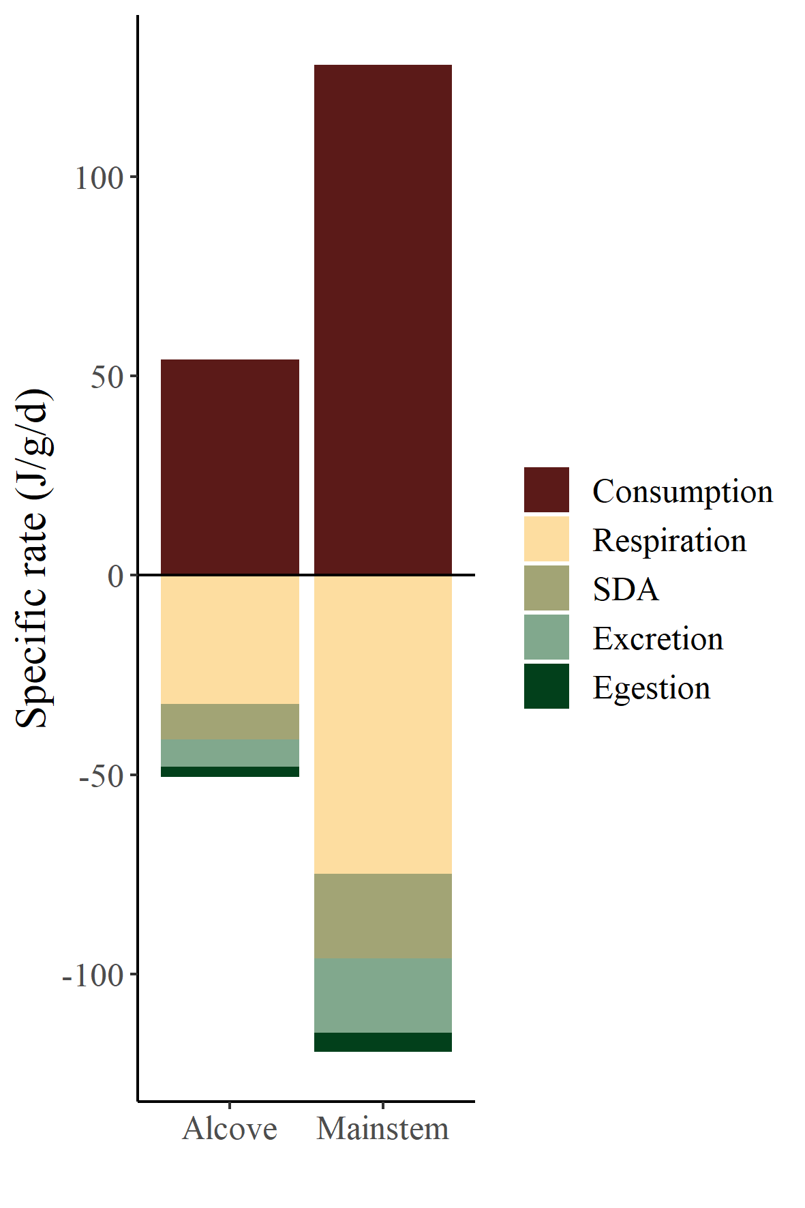
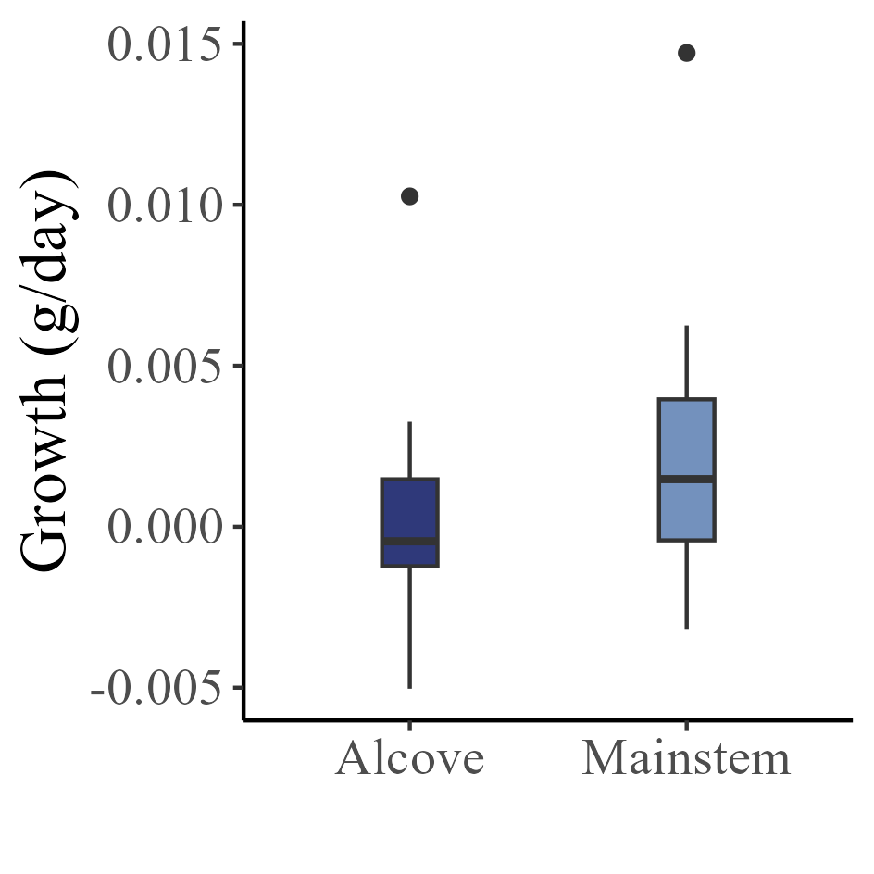
metabolism
wastes
Notes:
With our diet data, we can look at the modeled consumption comparing alcove and mainstem habitats. You can see here that the rate of consumption is far greater in the mainstem. Now lets add in the energy losses.
Per habitat, the rate of energy lost to metabolism and wastes roughly mirrors the rate of consumption for both habitats – meaning the energy balance and thus the potential for growth is nearly zero.
This is corroborated by growth data from our recaptured fish – growth is only slightly positive in both habitats.
The two strategies appear roughly equal, with mainstem fish putting on slightly more growth.

Slide 16
Will an energy maximizing approach in the mainstem be profitable in a warmer future?
1993-2011
2080
Notes:
But what about in a warmer future?
Mainstem temperatures projected to meet 22 degrees and be as high as 25 degrees some segments and tributaries.
How will increasing temperatures impact fish that stay in place and tolerate warm mainstem tempreatures.

Slide 17
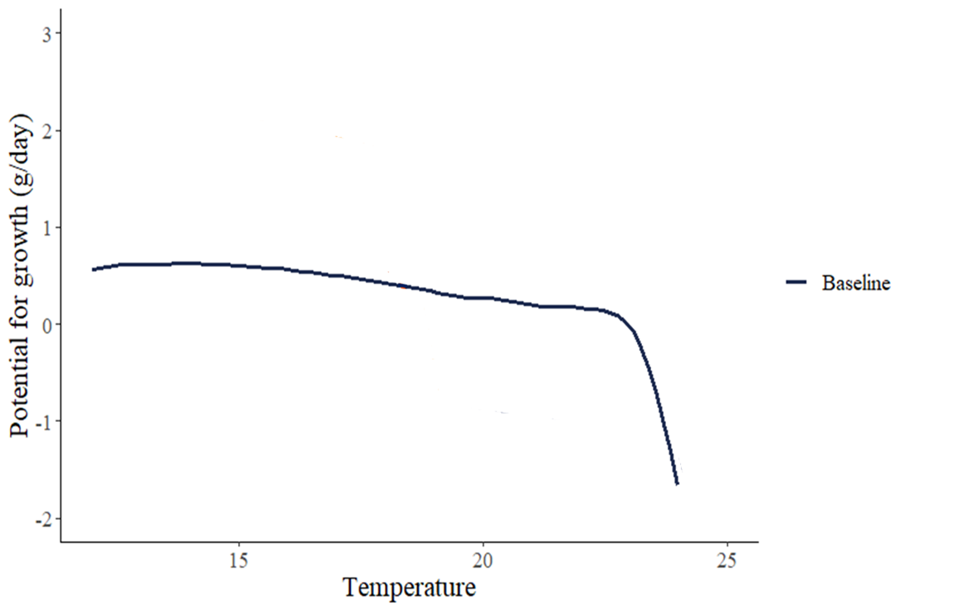
Will an energy maximizing approach in the mainstem be profitable in a warmer future?
3
2
1
Predicted growth (g/day)
0
-1
-2
15
20
25
Temperature (℃)
Notes:
We simulated how fish growth might respond to warming as a function of two variables – how much they’re eating and what their physiological tolerance is
To get oriented, here is a graph with temperature on the x axis and predicted growth in g/d on the y axis.
Here you can see our simulated predicted growth which is roughly constant until temperatures reach ~23, after which it drops off a cliff

Slide 18
Will an energy maximizing approach in the mainstem be profitable in a warmer future?
3
2
1
PCmax 0.3
Predicted growth (g/day)
0
-1
-2
15
20
25
Temperature (℃)
Notes:
This growth prediction is created assuming that our fish are eating at 30% of their maximum possible consumption, a Pcmax of 0.3 (reasonable for a wild fish).
Consumption is most impacting in near future – fish can eat their way out of increasing temperatures. But at some point, determined by fish physiology, consumption stops mattering (you can’t eat your way out anymore)
Future implications – first show map of temperature (supposed to get warmer) – only simulating for mainstem fish (alcoves will stay cold)
Simulation, we looked at how respond to warming as a function of two variables – what they’re eating and what their physiological tolerance is –
Super important to consider consumption
At some point consumption constrained then it becomes about intrinsic physiological tolerance – ultimately determines how long they can persist
Across rations and thermal tolerances

Slide 19
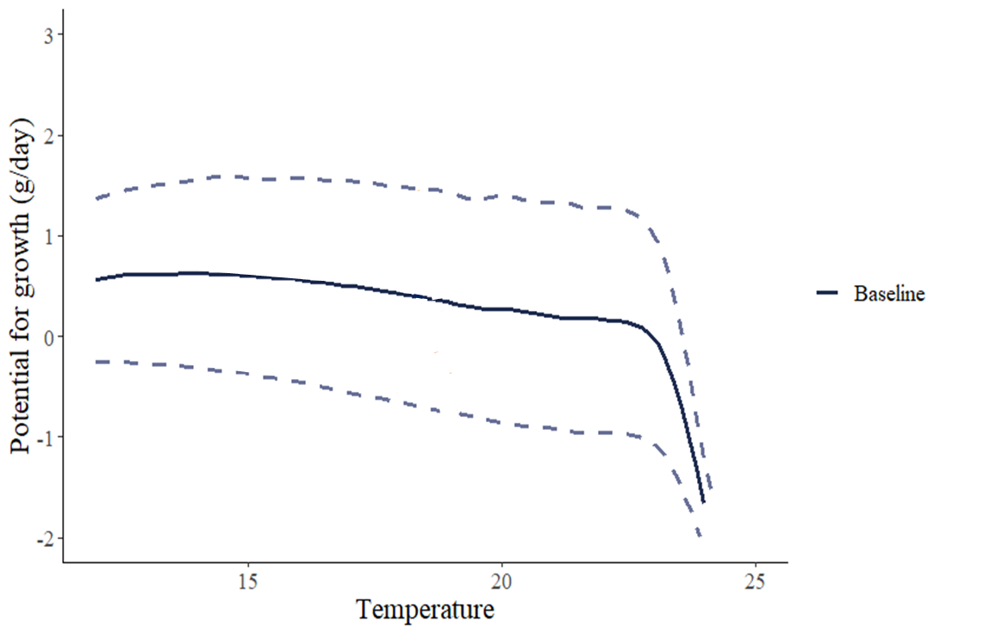
Will an energy maximizing approach in the mainstem be profitable in a warmer future?
3
2
PCmax 0.4
1
Predicted growth (g/day)
0
-1
PCmax 0.2
-2
15
20
25
Temperature (℃)
Notes:
We can adjust the Pcmax value to see how shifting consumption higher or lower would impact predicted growth. This shows that consumption is going to be the most impacting variable in the near future. Fish can essentially eat their way out of increasing temperatures by increasing their PCmax. However, at some set point, determined by fish physiology, consumption stops mattering (you hit the cliff and cant eat your way out anymore).
The point where consumption becomes constrained is based on intrinsic physiological tolerance – ultimately determines how long they can persist.

Slide 20
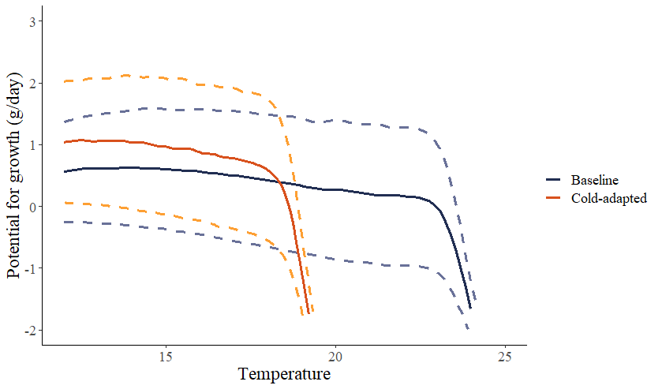
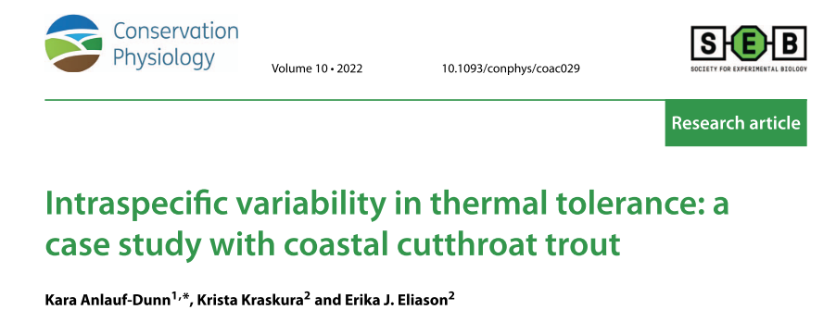
Will an energy maximizing approach in the mainstem be profitable in a warmer future?
3
2
1
Predicted growth (g/day)
0
-1
-2
15
20
25
Temperature (℃)
Notes:
Here, we’ve run the same simulation, but now for a more cold-adapted fish. Here you can see that once again increasing Pcmax can increase growth potential, but the precipitous dropoff in predicted growth occurs at much lower temperatures.
Differing species and populations will have different physiological limitations, which dictates when this cliff will occur.
Recent work by Kara Anlauf-Dunn on other cutthroat trout populations within the Willamette Valley watershed did not record a decrease in aerobic scope at temperatures as warm as 22℃. While it seems likely that our study fish would have similar thermal tolerance ranges, the fact that they are aggregated in thermal refuges would suggest that current peak mainstem temperatures (i.e. ~18-22°C) are suboptimal.

Slide 21
Key questions for future work
What underlies the alternative energetic tactics – why do fish in the same reaches of river do such different things during summer?
At what temperature do cutthroat reduce foraging due to thermal stress?
What does the energy budget look like for ‘migrate’ fish that move to the McKenzie River.
How should we account for life-history diversity in climate adaptation planning?

Slide 22
Thanks!!!!

